Slide 1

Agentic
AI
The Next Frontier of Autonomous Intelligence: Mastering Proactive Workflows and Multi-Agent Orchestration
Mr. Mohamed
December 27, 2025
SYS_REF: AGENTIC_V1.0 // 2025.12.27
Notes:
We are here today to talk about the next major evolution in artificial intelligence: Agentic AI. This isn't just about generating content anymore; it's about achieving goals autonomously. We're moving beyond simple content creation to mastering proactive workflows and orchestrating complex, multi-agent systems. This shift is fundamental. It changes how we think about AI's role, transforming it from a tool that answers questions into a system that executes entire projects. Over the next few minutes, we'll break down exactly what Agentic AI is and how you can start building with it.

Slide 2

Expertise in AI Engineering
and Instructional Leadership
Professional Background
Teaching Experience
Extensive experience in AI development and system architecture, focusing on scalable enterprise solutions.
Dedicated educator bridging the gap between complex AI theory and practical, real-world application.
Agentic AI Expertise
Specialized in building autonomous workflows and multi-agent systems using modern frameworks to transition from reactive to proactive AI.
Notes:
Before we dive in, let me quickly introduce myself. My background is rooted deeply in AI engineering and system architecture, focusing on building scalable enterprise solutions. But more importantly, I am an educator. I believe in bridging the gap between complex AI theory and practical, real-world application. My specialization lies in building autonomous workflows and multi-agent systems using modern frameworks. My goal today is to empower you to make that critical transition from reactive Generative AI to truly proactive Agentic systems. Now let's define what we mean by Agentic AI.

Slide 3

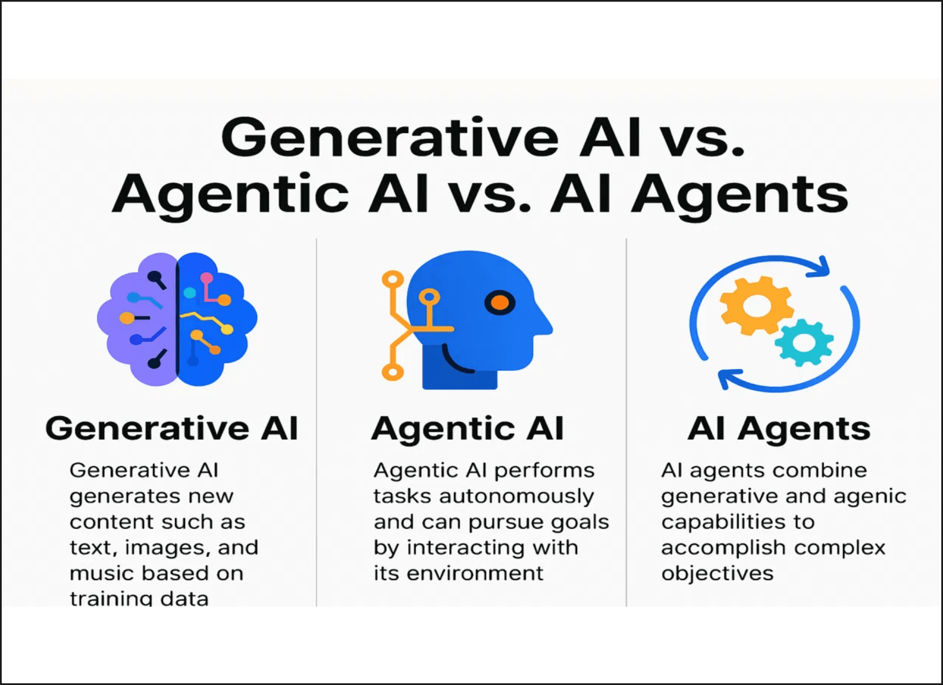
Agentic AI: The Paradigm Shift
Definition
Proactive AI systems that plan, reason, and execute tasks autonomously to achieve specific goals.
Key Characteristics
AUTONOMY & AGENCY
TOOL-USE CAPABILITY
SELF-CORRECTION
LONG-TERM PLANNING
Notes:
We just talked about the need to move from reactive to proactive AI. Agentic AI is the mechanism for that shift. Agentic AI systems are proactive; they don't just wait for a prompt. They plan, they reason, and they execute complex tasks autonomously to achieve a specific objective. This is the core philosophy: we are moving beyond asking "What can you write?" to asking "What can you achieve?" These systems are defined by their autonomy, their ability to use external tools, their capacity for self-correction, and their long-term planning skills. But how does this differ from the Generative AI we are all familiar with?

Slide 4

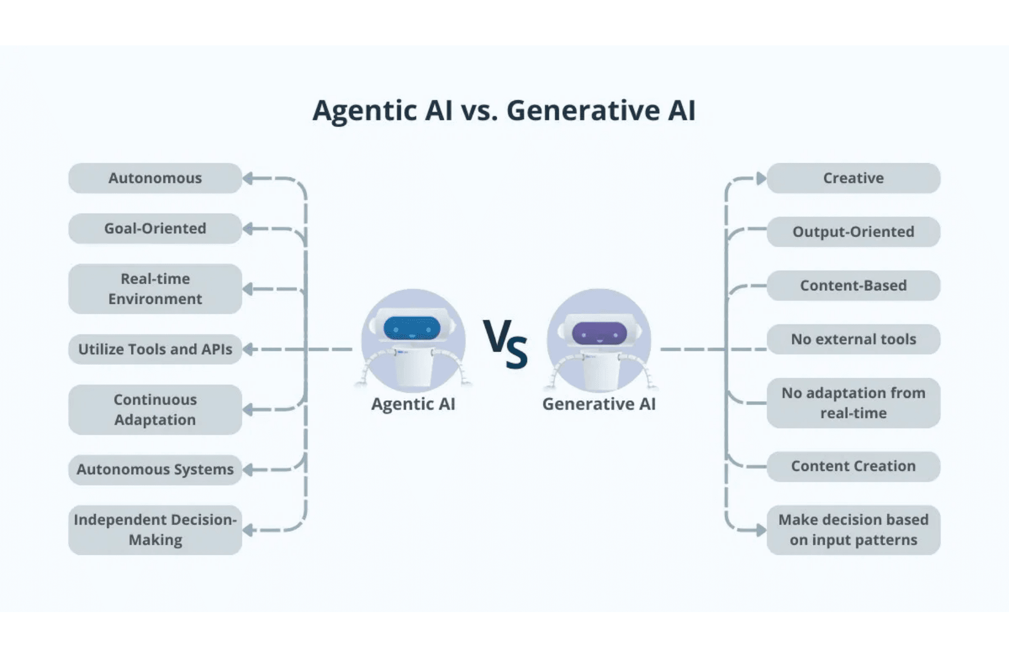
Proactive Agency vs.
Reactive Generation
Feature
Generative AI
Agentic AI
Nature
Reactive
Proactive
Focus
Content Creation
Task Execution
Workflow
Single-step
Multi-step / Iterative
Tools
Internal Knowledge
External APIs & Tools
Visualizing the Paradigm Shift
Notes:
The difference between Agentic AI and Generative AI is one of nature: proactive agency versus reactive generation. Generative AI is reactive; it follows a single prompt and focuses on creating content, whether that's text, images, or code. Agentic AI, however, is proactive and goal-oriented. Its focus is task completion, often involving complex, multi-step workflows. Look at the tools they use. Generative AI relies primarily on its internal knowledge base. Agentic AI, on the other hand, uses external APIs and tools—it has hands to interact with the real world. This capability for multi-step, tool-using execution is what makes it a true agent. This evolution didn't happen overnight; it's built on decades of AI research.

Slide 5
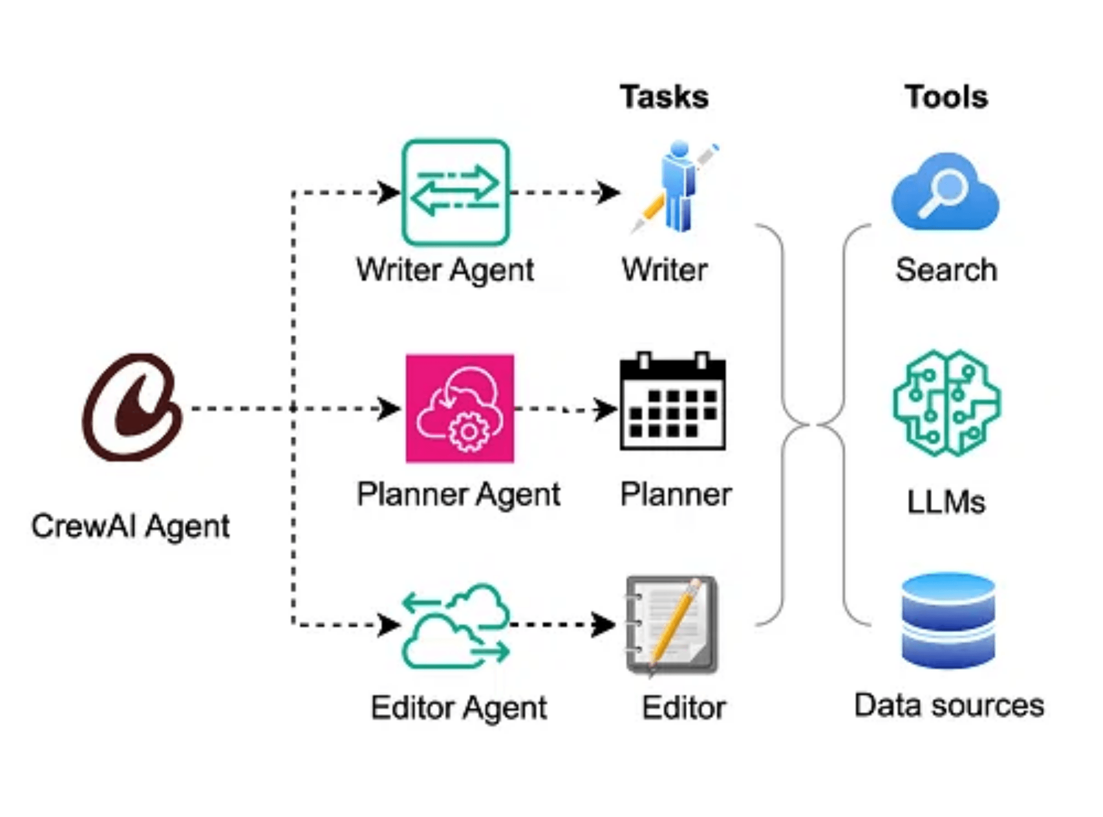
Evolution of
AI Agency
Level 01
Simple Reflex Agents
Immediate actions based on current perceptions without memory.
Level 02
Model-based Agents
Maintains internal state to track changes in the environment.
Level 03
Goal & Utility Agents
Actions driven by specific objectives and outcome optimization.
Level 04
Learning Agents
Continuously improves performance through feedback and experience.
Technical Schematic: Autonomous Agent Components
Notes:
The concept of an AI agent is not new; it has evolved significantly over time. We can categorize agents into four main levels of sophistication. At the simplest level, we have Simple Reflex Agents. They take immediate actions based only on their current perception, like a thermostat. Next, Model-based Agents maintain an internal state, allowing them to track changes in the environment over time. The real power comes with Goal and Utility Agents. These agents don't just react; they plan their actions to achieve specific objectives and optimize for the best possible outcome. Finally, Learning Agents continuously improve their performance through feedback and experience, making them truly autonomous. Understanding these levels helps us appreciate the complexity of the modern agent. Now, let's look inside and see what makes these sophisticated agents tick.

Slide 6

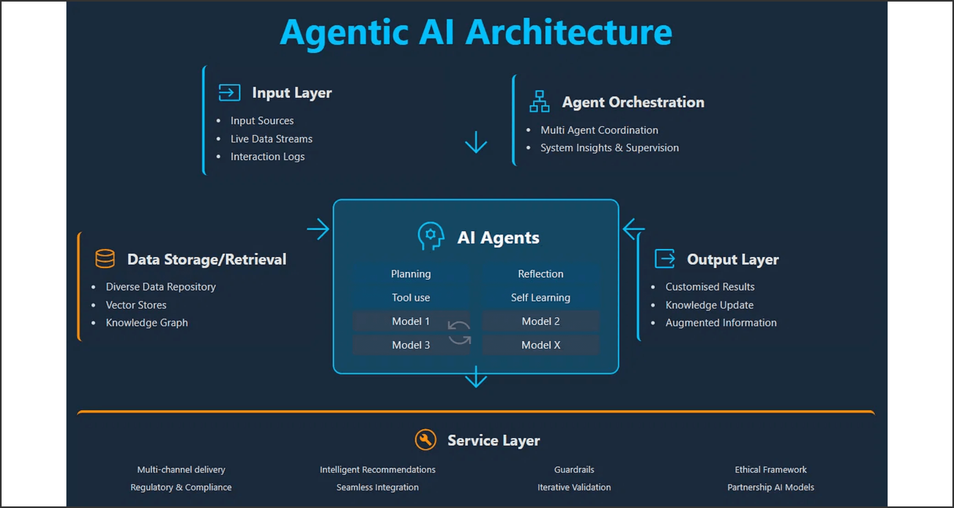
The Anatomy of an
Autonomous AI Agent
Component 01
Component 02
Component 03
Component 04
The Brain
Planning
Memory
Tools
Large Language Models (LLMs) serving as the core reasoning engine for logic and decision-making.
The ability to decompose complex goals into manageable sub-tasks and sequential steps.
Short-term context windows and long-term storage via Vector Databases for persistent knowledge.
The "hands" of the agent: APIs, web search, and code execution environments for real-world action.
Notes:
We've looked at the different types of agents, but now let's break down what's inside them. The autonomous agent isn't a monolith; it's a system of interconnected components. The LLM is the Brain, providing the core reasoning and logic that drives everything else. But a brain needs a plan. Planning is the critical function that breaks a complex goal into manageable, sequential sub-tasks. We also need Memory, both short-term context for the immediate task and long-term storage in vector databases for persistent knowledge. Finally, Tools are the agent's hands. These are the APIs, web searches, and code execution environments that let the agent interact with the real world. So, how do we get these individual agents to work together? That's where orchestration comes in.

Slide 7

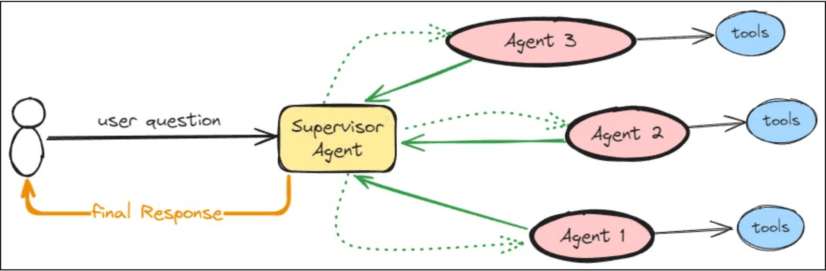
Orchestrating Intelligence through
Multi-Agent Collaboration
Architecture
Agent Orchestration
Managing the lifecycle, state, and communication protocols between autonomous entities.
Multi-Agent Systems (MAS)
Specialized agents (Researcher, Writer, Editor) collaborating to solve complex, multi-step problems.
FIG_07: MULTI-AGENT ORCHESTRATION WORKFLOW
Core Benefits
Enhanced scalability, specialized expertise, and cross-verification to minimize hallucinations.
Notes:
Once you have a well-defined agent, the next step is scaling its intelligence through collaboration. This is the heart of Multi-Agent Systems, or MAS. Orchestration is the process of managing the lifecycle, state, and communication between these specialized agents. Think of it like a project team: you have a Researcher agent feeding data to a Writer agent, who then passes the draft to an Editor agent. This collaboration brings huge benefits. We see enhanced scalability, specialized expertise for complex problems, and critically, reduced hallucination because agents can cross-verify information. This collaborative architecture is what truly unlocks complex, autonomous workflows. But even within a single agent or a team, we need a core reasoning strategy.

Slide 8

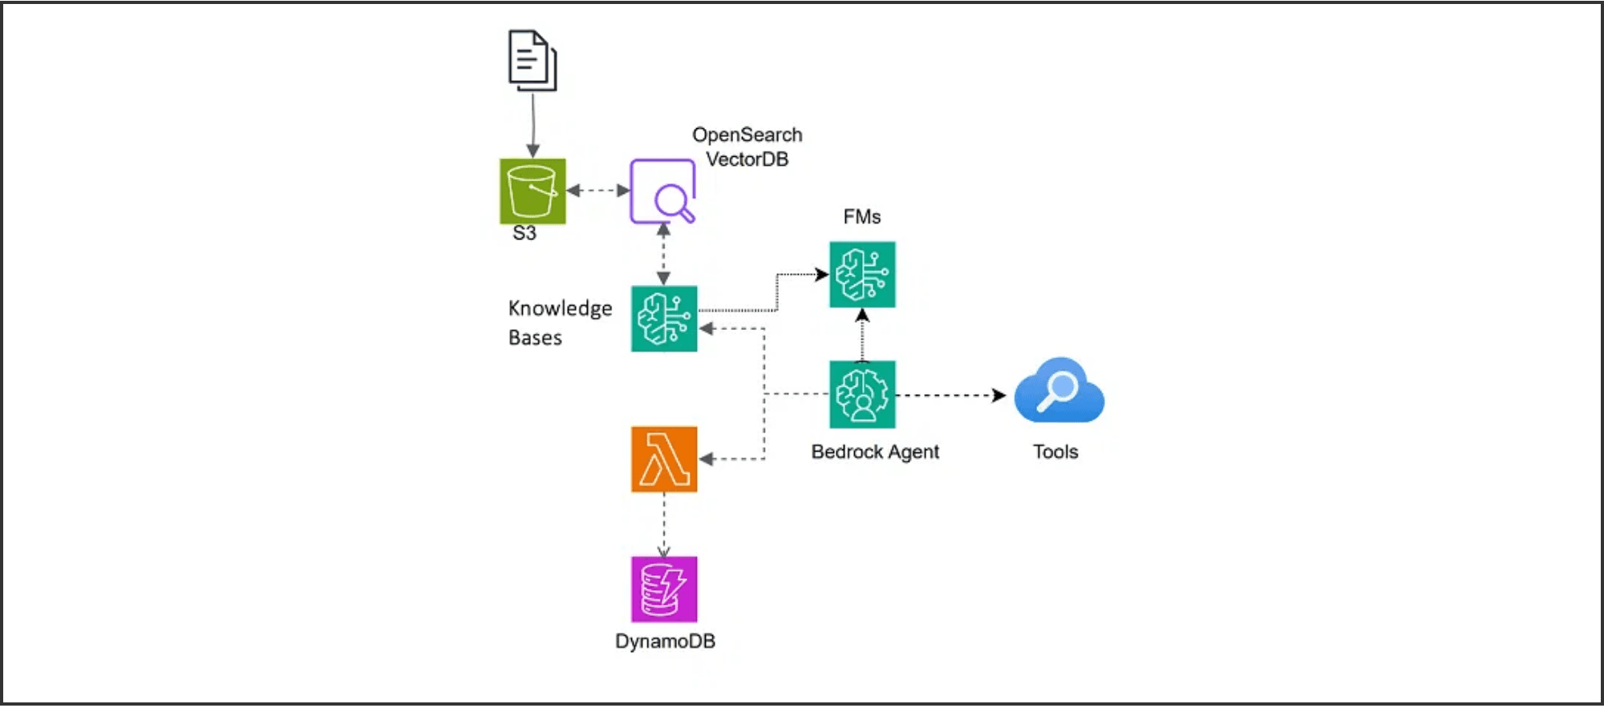
Strategic Planning vs.
Iterative Reasoning
FRAMEWORK_COMP_V2 // REASONING_LOGIC
ReAct
ReWOO
Reasoning + Acting
Reasoning Without Observation
Interleaves thinking and acting in a tight loop. The agent observes the environment after every action to decide the next step.
Decouples planning from execution. A "Planner" creates a full execution graph before any tools are called.
PLAN → EXECUTE → AGGREGATE
THINK → ACT → OBSERVE → REPEAT
Best for: Token efficiency, reducing latency, and predictable multi-step tasks.
Best for: Highly dynamic environments where information changes frequently.
Notes:
The choice of reasoning framework fundamentally dictates how an agent approaches a problem. We're comparing two major strategies here: ReAct and ReWOO. ReAct, or Reasoning plus Acting, is an iterative approach. The agent thinks, acts, observes the result, and then repeats the loop. This is perfect for dynamic environments where the information changes after every action. But sometimes, you need speed and efficiency. ReWOO, Reasoning Without Observation, decouples the planning from the execution. A Planner agent creates a full execution graph upfront, and then the agent executes it without stopping to observe. This is great for predictable, multi-step tasks where you want to reduce latency and token usage. These frameworks are the engine, but we need standards to build on.

Slide 9

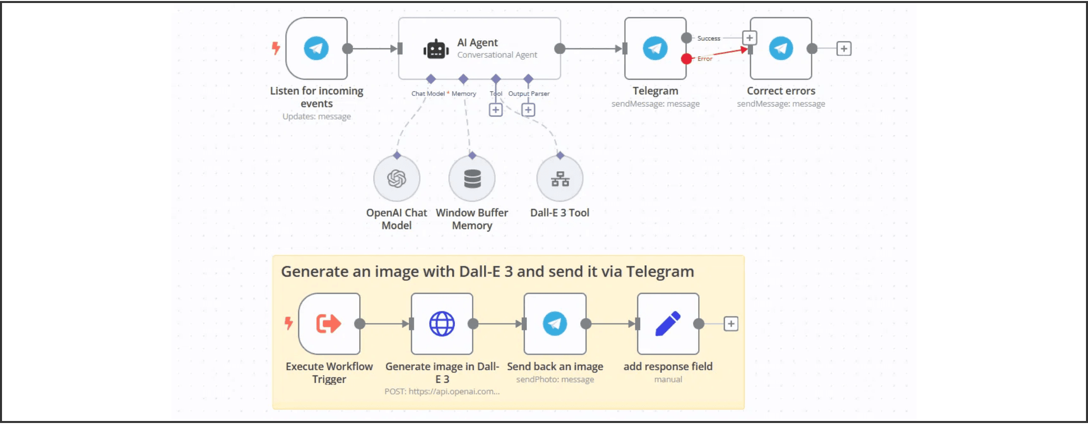
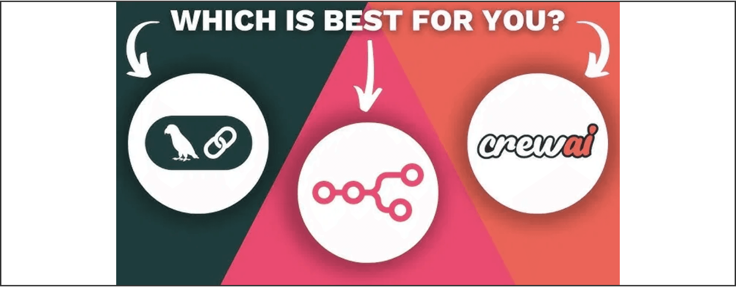
Standardizing the
Agentic Ecosystem
Industry Protocol
Model Context Protocol (MCP)
An open standard that enables seamless integration between AI models and their data sources, tools, and environments.
CrewAI
n8n
LangChain
Role-playing autonomous agents. Focuses on collaborative intelligence and program-flow orchestration.
Low-code workflow automation. Ideal for visual-based orchestration and enterprise tool integration.
The foundational framework for building LLM applications with modular components and chains.
Notes:
To move from bespoke projects to a robust ecosystem, we need standards and frameworks. The Model Context Protocol, or MCP, is a key open standard aiming to connect AI models seamlessly to their data sources and tools. This standardization is vital for interoperability. On the implementation side, we see leading frameworks like CrewAI, which focuses on role-playing, collaborative agents using a program-flow approach. Then you have n8n, which is a low-code, visual workflow automation tool, ideal for enterprise integration. And of course, LangChain remains the foundational library, providing the modular components for building these LLM applications. These tools give us the structure to build safe and accountable systems.

Slide 10

Ensuring Safe and Accountable
Autonomous Systems
Module 01
Module 02
Module 03
Ethics
Governance
Evaluation
Algorithmic Integrity
Operational Safety
Performance Metrics
Addressing systemic bias, ensuring
Implementing robust guardrails and
Utilizing frameworks like RAGAS to
transparency in decision-making, and
Human-in-the-Loop (HITL) checkpoints
quantitatively measure faithfulness,
establishing clear lines of accountability
to maintain control over complex agentic
relevance, and the overall reliability of
for autonomous actions.
workflows.
generated outputs.
GOV_ETHICS_FRAMEWORK // SECURE_AI_2025
Notes:
We've discussed the power of these systems, but with great power comes the need for strong governance. Building autonomous systems requires us to prioritize safety, accountability, and ethical design from the start. This involves addressing the black box problem and ensuring algorithmic integrity so we can trust the decisions our agents make. We must also implement robust governance, meaning we need Human-in-the-Loop checkpoints and clear guardrails to maintain operational safety in complex workflows. Finally, we need to evaluate these systems using metrics like RAGAS to quantitatively measure faithfulness and relevance, ensuring the outputs are reliable. Now let's look at how we can apply this agentic mindset to a common problem like Retrieval Augmented Generation.

Slide 11

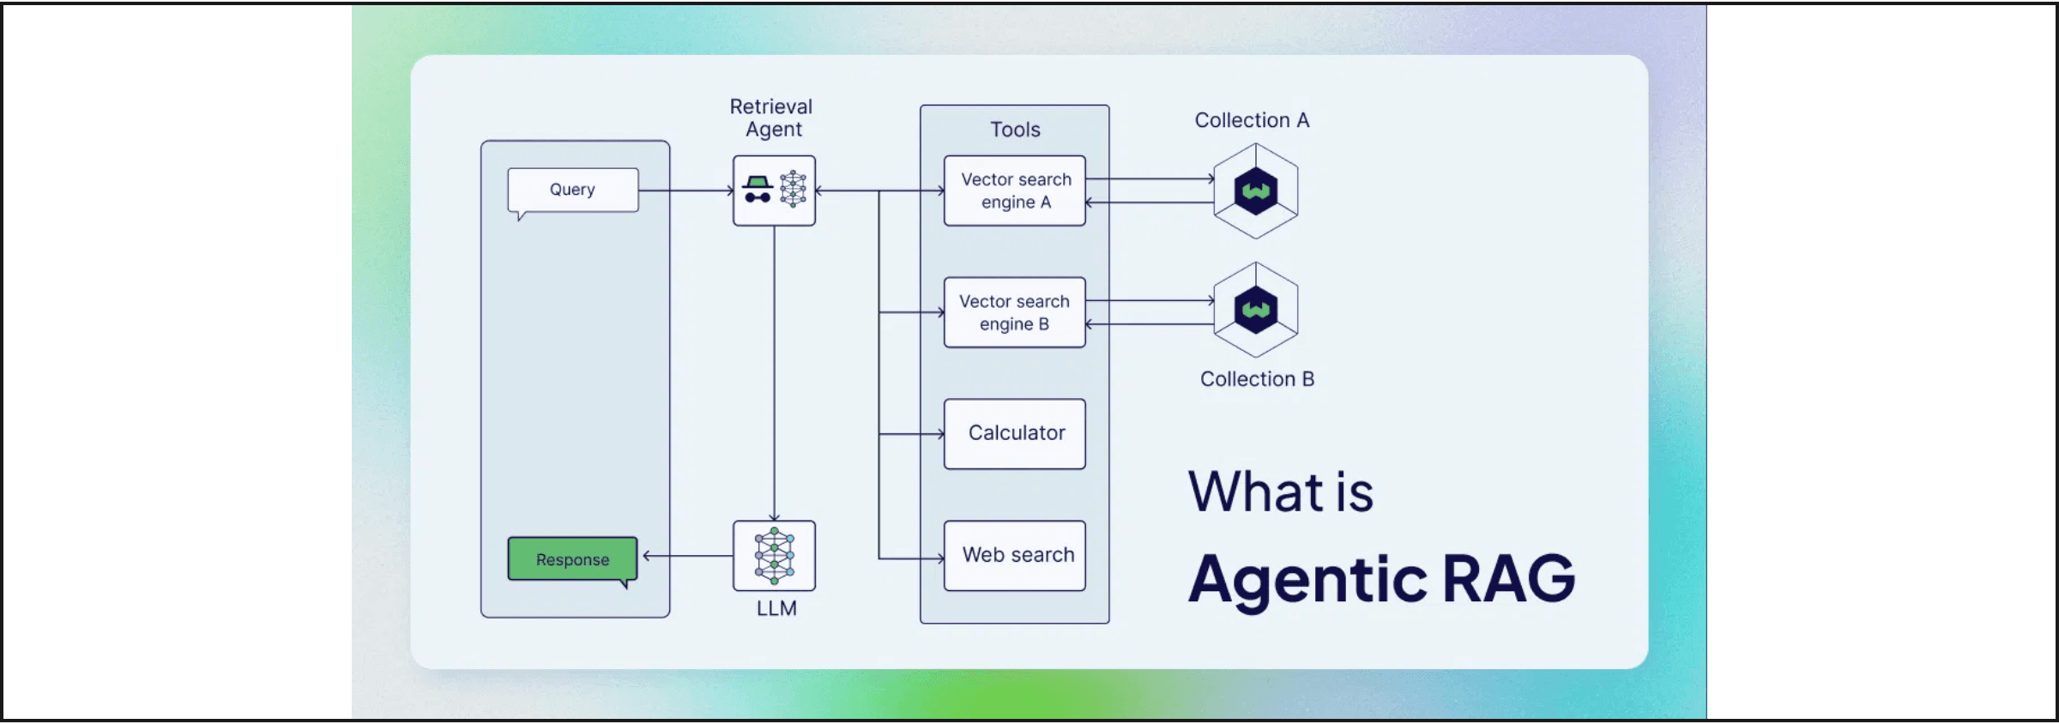
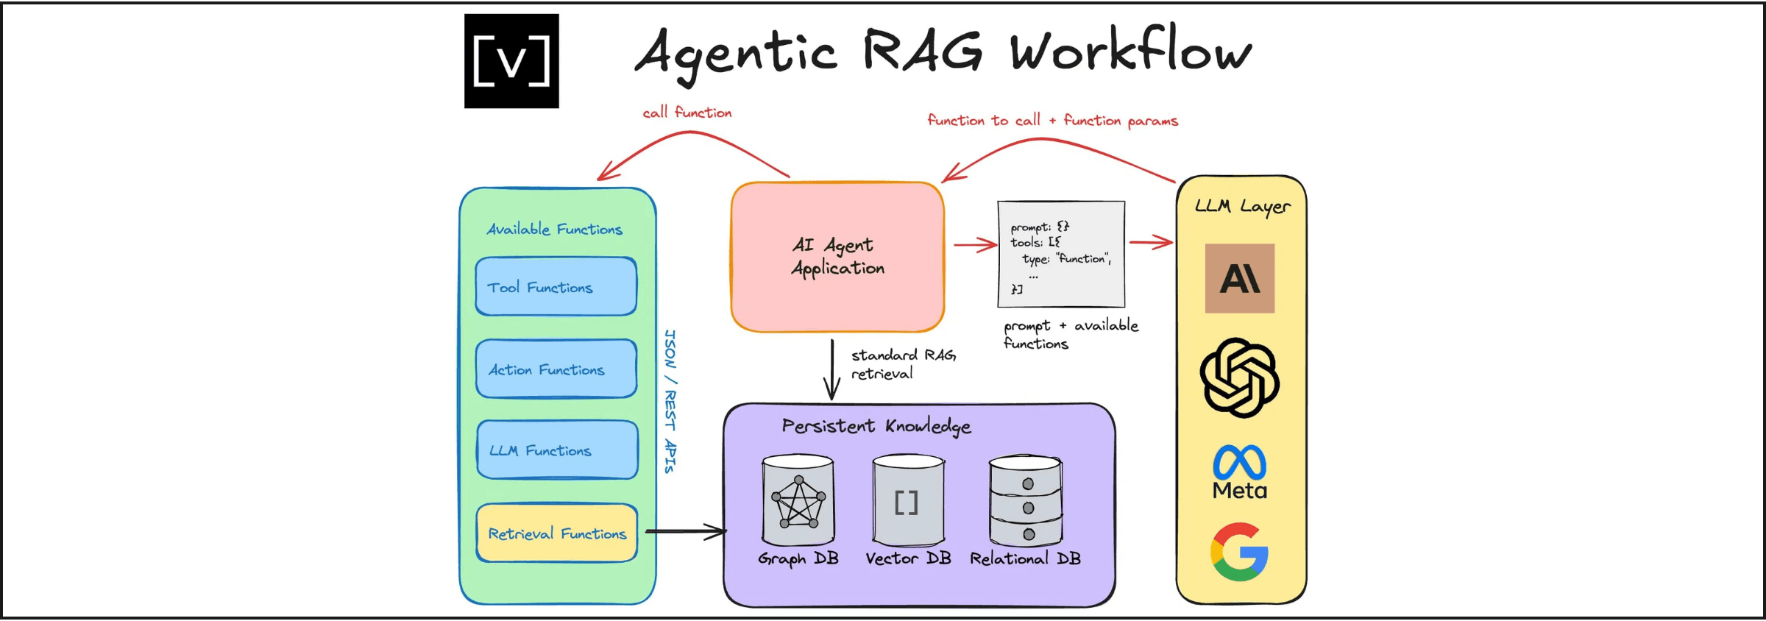
Beyond Retrieval: Agents that
Critique and Refine Knowledge
The Concept
Agentic RAG upgrades standard retrieval by integrating LLM-powered agents to introduce autonomous decision-making and iterative refinement.
Retriever Router
FIG_11A: AGENTIC RAG ARCHITECTURE OVERVIEW
Intelligently analyzes queries to select the optimal data source (SQL, Vector DB, or Web Search).
Answer Critic
Evaluates generated responses for accuracy and completeness, triggering further retrieval if gaps are found.
FIG_11B: ITERATIVE REFINEMENT WORKFLOW
Notes:
Moving from general governance, let's see how the agentic mindset transforms a core LLM application: RAG. Standard RAG is often passive, but Agentic RAG introduces autonomous decision-making and iterative refinement to the process. We introduce two key agents here: the Retriever Router and the Answer Critic. The Retriever Router intelligently analyzes the query and decides which data source is optimal, whether it's a vector database or a web search. The Answer Critic then evaluates the generated response for accuracy and completeness, and if it finds gaps, it triggers further retrieval. This iterative loop is what moves us beyond simple retrieval to true knowledge refinement. This kind of sophisticated workflow requires the right tools, which brings us to our final topic.

Slide 12

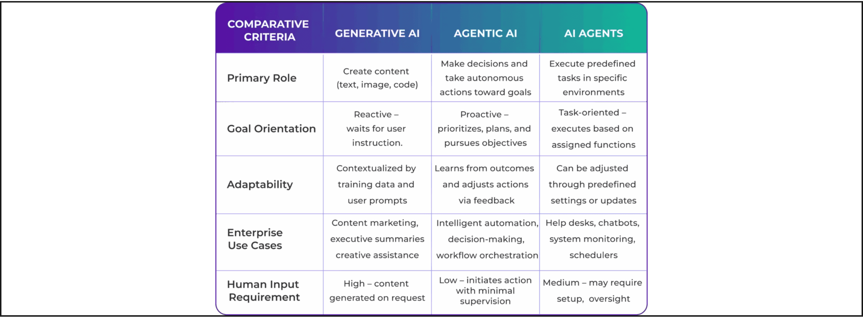
Choosing the Right Tool
for the Mission
Workflow-Based
Program-Flow
n8n
CrewAI
Visual, low-code automation platform. Ideal for complex enterprise integrations, API orchestration, and visual logic flows.
Python-centric framework for orchestrating autonomous role-playing agents. Best for complex reasoning and collaborative tasks.
Practical Demonstration Scenario
Automating a multi-step Research & Reporting Pipeline: From web scraping and data synthesis to final document generation.
Notes:
We've covered the theory, the frameworks, and the ethics, so now we ask: which tool do you use to build this? The choice depends entirely on your mission and your team's expertise. On one hand, you have n8n, which is a visual, low-code platform perfect for enterprise integrations and complex logic flows where you need a visual representation of the workflow. On the other hand, you have CrewAI, which is Python-centric and excels at orchestrating autonomous, role-playing agents for complex reasoning tasks. We'll now demonstrate how we can use both of these approaches to automate a multi-step research and reporting pipeline, showing you the strengths of each tool in action.

